Slide 1
Runtime Verification From theory to practice and back
Gordon J. Pace
(joint course design with Christian Colombo)
University of Malta
September 2016

Slide 2
Part I
LTL

Slide 3
LTL Formulae
Example of specification of good behaviour (assuming events don’t happen concurrently):
!login Until initialise

Slide 4
LTL
ψ ::= event
| ¬ψ
| ψ∧ψʹ
| X ψ
| G ψ
| ψ U ψʹ

Slide 5
LTL
ψ ::= event
| ¬ψ
| ψ∧ψʹ
| X ψ
| G ψ
| ψ U ψʹ
This is the first event of the behaviour of the system

Slide 6
LTL
The formula “login” is satisfied by the trace:
but not by:
ψ ::= event
| ¬ψ
| ψ∧ψʹ
| X ψ
| G ψ
| ψ U ψʹ
login
buyItem
logout
buyItem
login
logout

Slide 7
LTL
ψ ::= event
| ¬ψ
| ψ∧ψʹ
| X ψ
| G ψ
| ψ U ψʹ
Formula ψ does not hold

Slide 8
LTL
Formula “¬login” is satisfied by the trace:
but not by:
ψ ::= event
| ¬ψ
| ψ∧ψʹ
| X ψ
| G ψ
| ψ U ψʹ
logout
buyItem
login
login
buyItem
returnItem

Slide 9
LTL
ψ ::= event
| ¬ψ
| ψ∧ψʹ
| X ψ
| G ψ
| ψ U ψʹ
Both ψ and ψʹ hold

Slide 10
LTL
Formula “¬login∧¬logout” is satisfied by:
but not by:
ψ ::= event
| ¬ψ
| ψ∧ψʹ
| X ψ
| G ψ
| ψ U ψʹ
sellItem
buyItem
login
login
buyItem
returnItem

Slide 11
LTL
Other logic operators may be defined as syntactic sugar of these two:
ψ∨ψʹ ≡ ¬(¬ψ∧¬ψʹ)
ψ⇒ψʹ ≡ ¬ψ∨ψʹ
ψ⇔ψʹ ≡
ψ⇒ψʹ ∧ψʹ⇒ψ
ψ ::= event
| ¬ψ
| ψ∧ψʹ
| X ψ
| G ψ
| ψ U ψʹ

Slide 12
LTL
ψ ::= event
| ¬ψ
| ψ∧ψʹ
| X ψ
| G ψ
| ψ U ψʹ
Ignoring the current event, ψ will hold

Slide 13
LTL
Formula “login∧¬X logout” is satisfied by:
but not by:
ψ ::= event
| ¬ψ
| ψ∧ψʹ
| X ψ
| G ψ
| ψ U ψʹ
login
buyItem
logout
login
logout
login

Slide 14
LTL
ψ ::= event
| ¬ψ
| ψ∧ψʹ
| X ψ
| G ψ
| ψ U ψʹ
Formula ψ will hold in all future points in time

Slide 15
LTL
“G (login⇒¬X logout)”
is satisfied by:
but not by:
ψ ::= event
| ¬ψ
| ψ∧ψʹ
| X ψ
| G ψ
| ψ U ψʹ
login
buyItem
logout
login
login
login
buyItem
logout
login
logout

Slide 16
LTL
ψ ::= event
| ¬ψ
| ψ∧ψʹ
| X ψ
| G ψ
| ψ U ψʹ
Eventually, formula
ψʹ will hold, but until then ψ will hold

Slide 17
LTL
“transfer U X logout”
is satisfied by:
but not by:
ψ ::= event
| ¬ψ
| ψ∧ψʹ
| X ψ
| G ψ
| ψ U ψʹ
transfer
transfer
transfer
logout
login
login
buyItem
logout
login
logout

Slide 18
LTL
Other temporal operators may be defined as syntactic sugar as with:
Fψ≡ true U ψ
ψR ψ’ = ¬(¬ ψ U ¬ ψ’)
Even the G operator could have been defined:
Gψ≡ ¬(F¬ψ)
ψ ::= event
| ¬ψ
| ψ∧ψʹ
| X ψ
| G ψ
| ψ U ψʹ

Slide 19
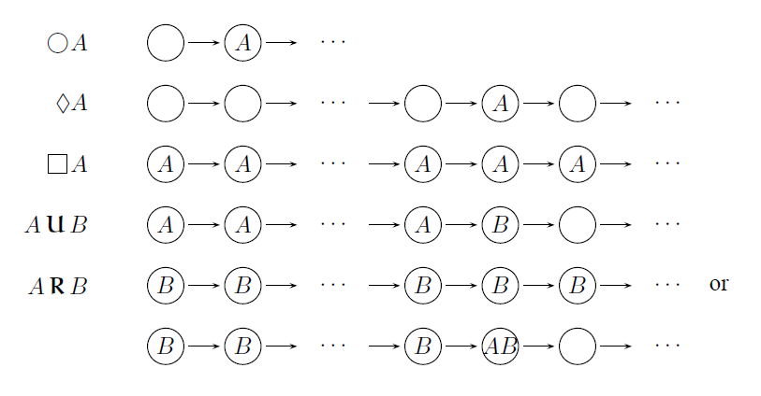
Pictorially…

Slide 20
LTL
A logout must have been preceded by a login: ¬logout U login
More generally, for multiple sessions: (¬logout U login) ∧ (G(logout ⇒ X (¬logout U login)))
Transfers only occur between a login and a logout (single session version): (¬transfer U login) ∧ (G (logout ⇒ G¬transfer))

Slide 21
LTL Formulae
Example of specification of good behaviour:
!login Until initialise
(!transfer Until login) and (Globally (logout => Next (!transfer Until login)))

Slide 22
Exercise
Express properties 2, 5, and 10 of the Financial Transaction System in terms of LTL

Slide 23
Example
Property 2 - The transaction system must be initialised before any user logs in.
property matching {
(not USER_login) Until initialise
}

Slide 24
More Advanced Example
Property 5 – Once a user is disabled, he or she may not withdraw from an account until being made activate again.
property foreach target (UserInfo u) matching {
((not transfer) Until login) and (Globally (logout => Next((not transfer) Until login)))
}

Slide 25
Monitoring LTL Formulae
Verification can be done either by:
By using the residual (rewriting) algorithm or
Transforming into an automaton

Slide 26
Disadvantage of Residuals
While using residuals it is quite easy to build a monitor…
… it involves significant overhead at runtime
(imagine how many times the rules would have to be checked for a significantly long LTL formula)

Slide 27
Part II
Monitoring LTL using Automata

Slide 28
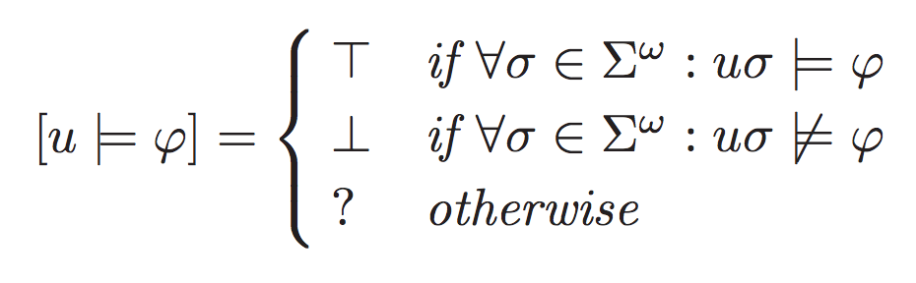
LTL – yes, no, ?

Slide 29
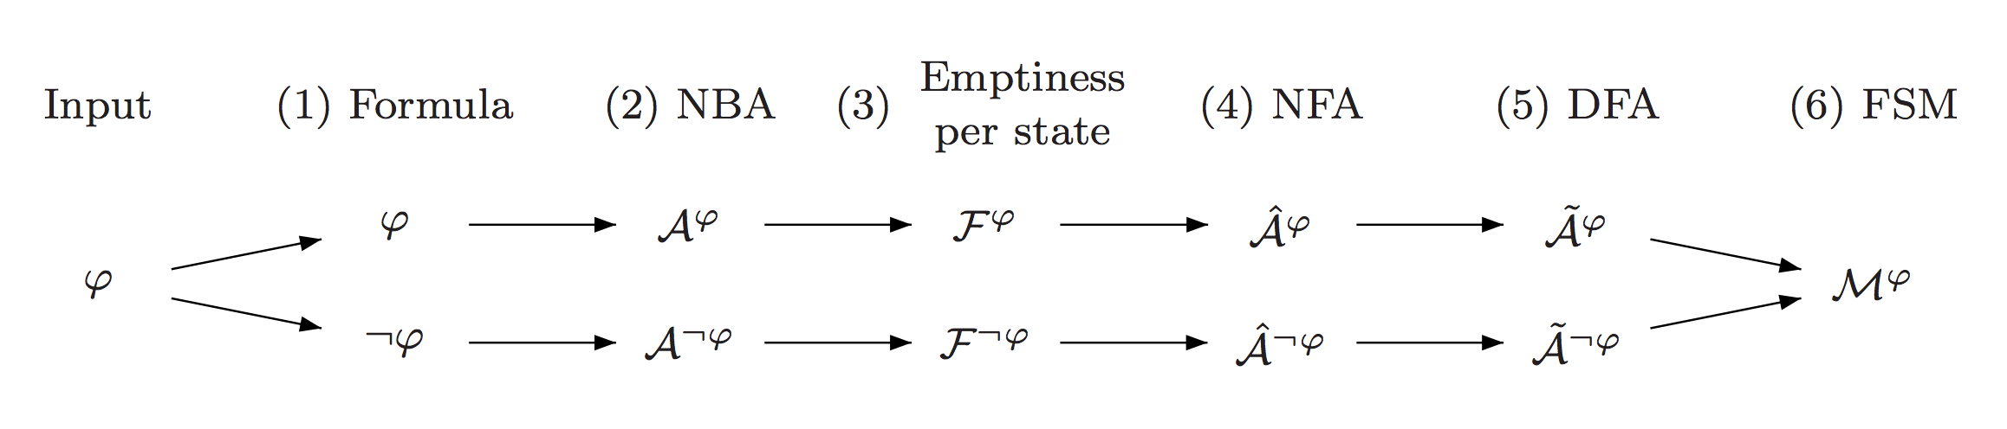
LTL to Automata

Slide 30
LTL to Automata
Standard translation to Buchi automata

Slide 31
LTL to Automata
Identify states which can lead to violation

Slide 32
LTL to Automata
Generate finite automaton whose final states correspond to states leading to violation

Slide 33
LTL to Automata
Determinise the automaton

Slide 34
LTL to Automata
Combine both decision procedures to achieve:

Slide 35
Exercises
Edit the method toAspectJAutomata( ) in LTLExp.java to generate the product automaton.

